Slide 1
Indo Arabian Global General Trading LLC.
Al Quoz , PO Box 390211, Dubai, United Arab Emirates
(Tel): +971 4 3415210 | (Fax: ) +971 4 3415620 |
inarco@emirates.net.ae | www.inarcodubai.com
One of the leading suppliers of House keeping equipment's & Accessories, Banquet furniture, Kitchen Utensils, Bed & Bath linen, Amenities, Glass wares, Cutlery, Crockery……

Slide 2
COMPANY PROFILE
Indo Arabian Global General Trading L.L.C. Founded on 1st January 2009, Aiming at Providing Best Service to all Kind of 5 Star, 4 Star & 3 Star Hotels, Restaurants, Catering Companies, Hospital Etc.
INARCO (Indo Arabian Global General Trading) has come a long way in serving the hospitality industry with fully functional staff and extends all service support. Our warehousing, networking and logistics team help service every client through out the UAE & GCC round the clock from the time of order.
We take special care in selecting renowned brands for our valued clients and supply high quality materials at a reasonable price.

Slide 3
VISION
To reach our quality products to the finest hotels around the globe.
MISSION
Maximum customer satisfaction through highest standards and quality of products.
Our Products and Brands
Our Product Range covers Kitchen Utensils and Equipment, Housekeeping Linen and Accessories, F&B Service Equipment and Accessories etc. Products are of Origin from Europe, USA, France, Italy, Greece, China, Turkey & India.
Our Trading Division covers most of the international Brands which are used all over the world. We can Supply Goods As per the Requirement and Required Quality Anywhere in GCC, South Asia and Africa.

Slide 4










BRANDS COUNTRY OF ORIGIN
Mallard Ferriere France
Sanelli ITALY
Fairway China
Pujadas Spain
Bugatti Italy
Crystalite Bohemia Czech Republic
Kinhao China
Ormel Turkey
Garibaldi Greece
Evinocks Turkey

Slide 5
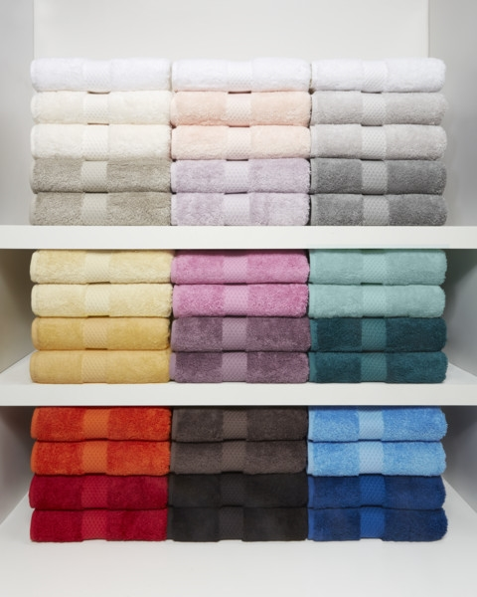
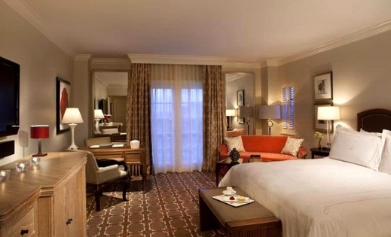
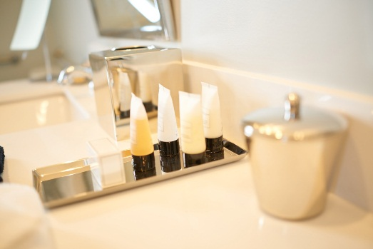

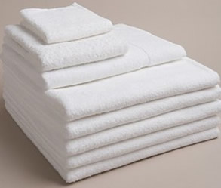
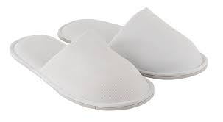
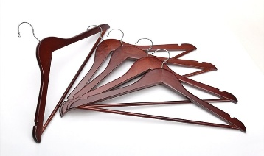
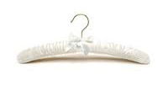
Few of our Products

Slide 6
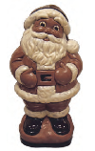

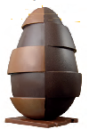

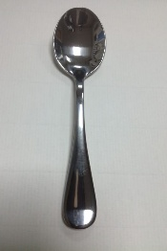
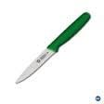

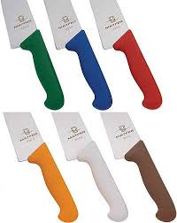

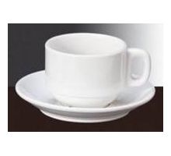
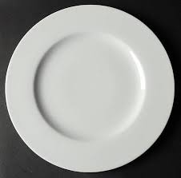
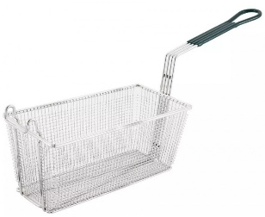

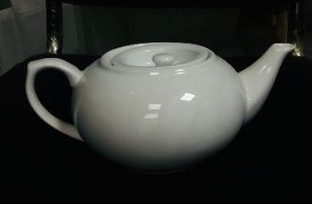
Few of our Products

Slide 7
















Few of our Clients

Slide 8






